Slide 1


Slide 2
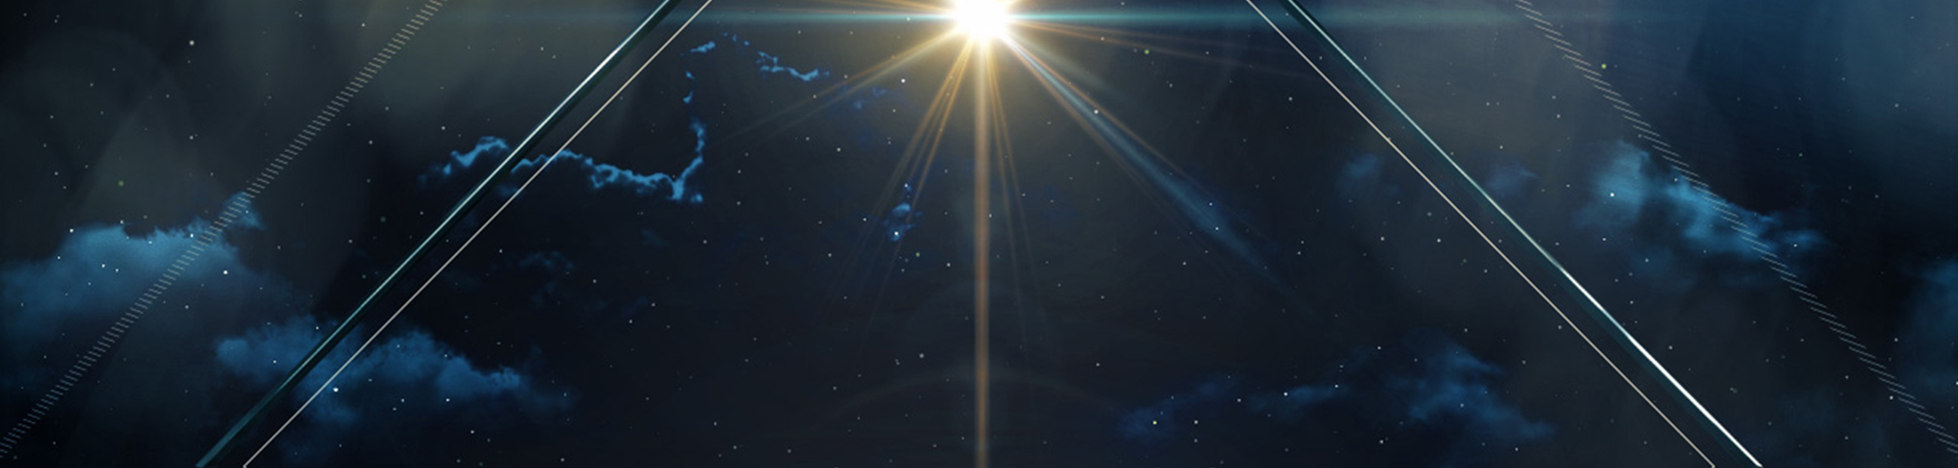

Luke 3:38 Which was the son of Enos, which was the son of Seth, which was the son of Adam, which was the son of God.

Slide 3
Genesis 1:26a And God said, Let us make man in our image, after our likeness: and let them have dominion…
²⁷ So God created man in his own image, in the image of God created he him; male and female created he them. ^{28a} And God blessed them, and God said unto them, Be fruitful, and multiply, and replenish the earth, and subdue it:
²⁹ And God said, Behold, I have given you every herb bearing seed, which is upon the face of all the earth, and every tree, in the which is the fruit of a tree yielding seed; to you it shall be for meat.

Slide 4
Isaiah 9:6-7 For unto us a child is born, unto us a son is given: and the government shall be upon his shoulder: and his name shall be called Wonderful, Counsellor, The mighty God, The everlasting Father, The Prince of Peace. ⁷ Of the increase of his government and peace there shall be no end, upon the throne of David, and upon his kingdom, to order it, and to establish it with judgment and with justice from henceforth even for ever. The zeal of the LORD of hosts will perform this.

Slide 5
Romans 6:23 For the wages of sin is death; but the gift of God is eternal life through Jesus Christ our Lord.
EACH MUST CHOOSE.

Slide 6
1 Peter 2:21-24 For even hereunto were ye called: because Christ also suffered for us, leaving us an example, that ye should follow his steps: ²² Who did no sin, neither was guile found in his mouth: ²³ Who, when he was reviled, reviled not again; when he suffered, he threatened not; but committed himself to him that judgeth righteously: ²⁴ Who his own self bare our sins in his own body on the tree, that we, being dead to sins, should live unto righteousness: by whose stripes ye were healed.

